Slide 1


Final Year Project Presentation

Slide 2
ONLINE BIDDING PORTAL DEVELOPED BY HUMZA HASAN
UNDER SUPERVISION OF
MOUSUMI SAHA
(Assistant Professor)
Computer Science & Engineering

Slide 3


INTRODUCTION
V/S

Slide 4

OBJECTIVES
User – Sells and Bids for products

Slide 5




PROPOSED APPROACH
+
+
=

Slide 6
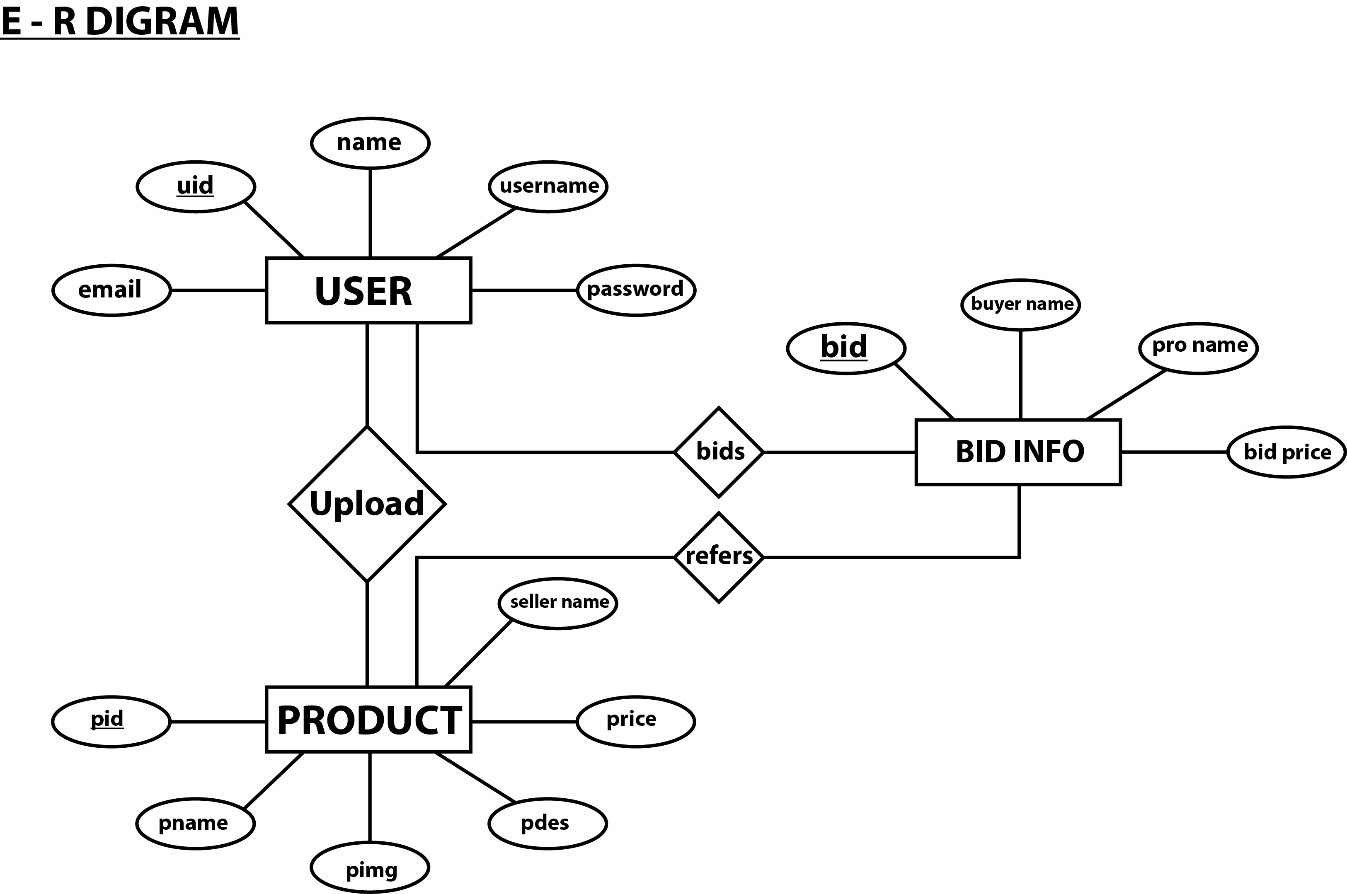
ER DIAGRAM

Slide 7
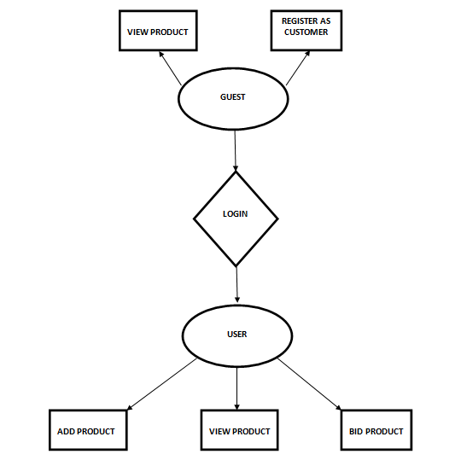
System Flow Diagram

Slide 8



FUTURE WORK

Slide 9
CONCLUSION
System development cost
System performance
Software re-engineering

